Slide 1
Introduction To Neural Networks and AI.
By Mustafa Behrainwala

Slide 2
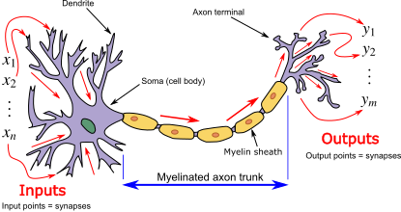
What is a Neuron?
Neuron in an AI
Input
Output
Weight

Slide 3
A Simple Linear Regression Neural Network
Input 1
Weight(i1, o1)
Output 1
Weight(i1, o2)
Weight(i2, o1)
Input 2
Weight(i2, o2)
Output 2

Slide 4
What is an Artificial Neural Network?
It is a statistical model which will use the sum of the trained weights multiplied by the inputs to predict an output.
i.e. Output1=Input1*Weight1+Input2*Weight1

Slide 5
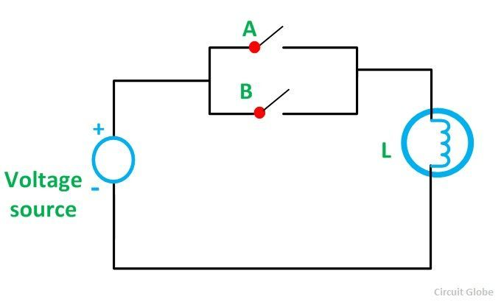
An OR gate

Slide 6
What does that mean for a neural network
We can train this simple NN to recognise any of the inputs to be high to generate a 1 on the output.
Input1
Output1
Input2
Output2

Slide 7
Activation Function in a Neural Network.
Why do we need Non-linear activation function?
A neural network without an activation function is essentially just a linear regression model. The activation function does the non-linear transformation to the input making it capable to learn and perform more complex tasks.
The different kinds of Activation function are
Sigmoid, Tangent Hyperbolic, Rectified linear unit (RelU)

Slide 8
Using a RelU
Simplest activation function
Very fast compared to others
A(x) = max(0,x)
Derivative of RelU
dA/dX = {x<=0?0:1}

Slide 9
Training the Neural Network.
To train a neural network we need to find out how much the neural network was wrong by and then tell the neural network to correct its self by that amount.
This technique is known as back propagation and the mathematical term for this is called gradient estimation.
The way a neural network will perform this is by adjusting each weight by doing a gradual gradient walk towards the minimum value required to correctly guess the output.
Remember Output1=Input1*Weight1+Input2*Weight1

Slide 10
What did we train our Network to do?
1
Input 2
Output 1
Output 2
0,0
1
Input 1

Slide 11
What did we train our OR Network to do?
1
Input 2
.9,.9
True
False
0,0
1
Input 1

Slide 12
What did we train our Age NN to do?
1
Weight
.40
Adult
Child
0,0
1
Height
.130

Slide 13
Modify our Age NN to account for Gender
1
Weight
gender
.40
Adult
Child
0,0
1
Height
.130

Slide 14
What about an XOR gate
1
Input 2
.9,.9
True
False
False
True
0,0
1
Input 1

Slide 15
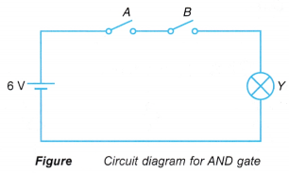
Issues with an And Gate
The neural network can only tell if the either input is +ive or 0 and have a gradient based on that.
Due to this we can never have an And gate with out neural network.

